Slide 1
ISLR Chapter 4 Classification
Logistic Regression
(reviewed by B. Haas, 11/2014)

Slide 2
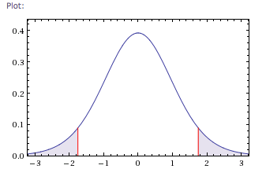
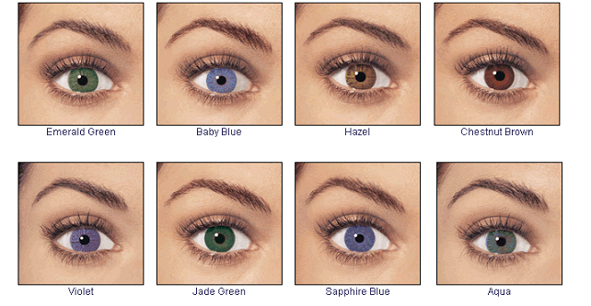
Quantitative vs. Qualitative Response Variable
Quantitative: Y = (some numerical value)
Qualitative: Y = (some categorical variable)
eg. eye color

Slide 3
Classification: predicting qualitative values, or assigning observations to a category or a class.
Most widely used classifiers include:
Logistic regression (this week)
Linear discriminant analysis (next week)
K-nearest neighbors
Computer intensive methods:
Generalized additive models (Chapter 7)
Trees, Random forests, Boosting (Chapter 8)
Support vector machines (chapter 9)

Slide 4
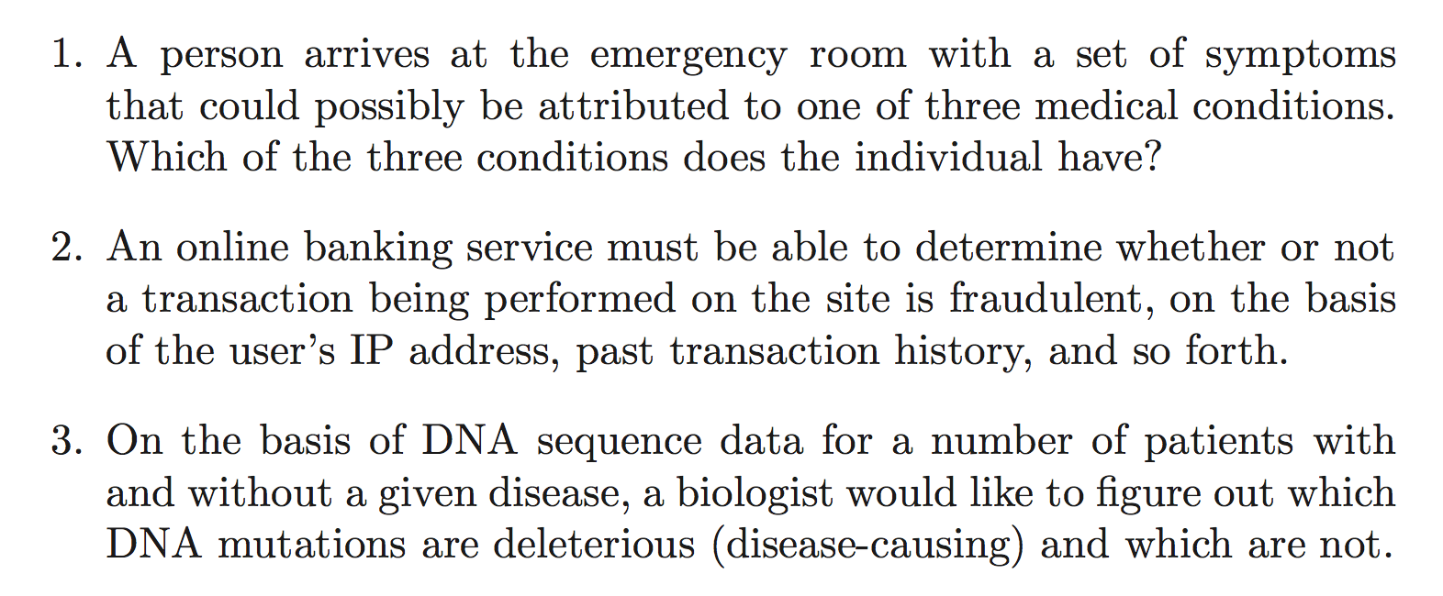
Examples of Classification Problems
Linear Regression is Not Appropriate for Predicting Qualitative Response Variables

Slide 5
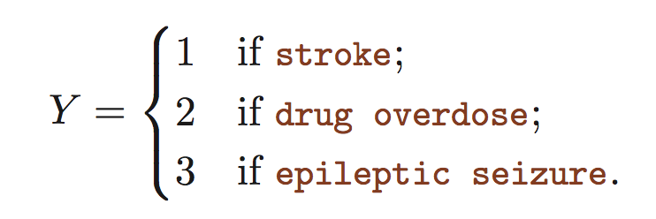
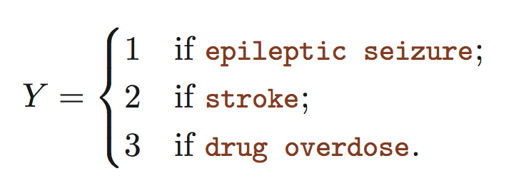
Why Linear Regression Not Appropriate for Qualitative Response?
Alternative potential encodings for response variable:
Either implies an ordering and relative relationship among the possible responses, which may not make sense. Different encodings lead to different linear models.

Slide 6
There are some cases where linear regression could be appropriate
A clear numerical relationship exists among the response variable values:
0 if mild;
If moderate;
If severe.
Y =
Ok, if mild < moderate < severe and we agree on their relative differences in values.

Slide 7
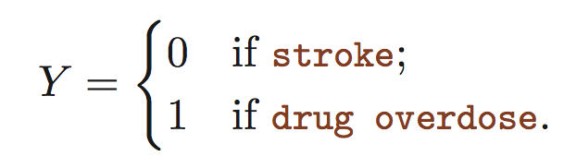
There are some cases where linear regression could be appropriate
The response variable is binary (0|1)
Encode Response for Training
Prediction using linear regression:
< 0.5 stroke;
else drug overdose.
Y =
Can interpret as Y = P(drug overdose|X)
Problem: Not really P-values, as linear regression line can go below zero and above 1.

Slide 8
‘Default’ data set for studying classification
Response variable:
will a person default on their credit card payment. (Yes/No)
Explanatory variables:
Annual income
Monthly credit card balance
Goal is to predict (default) ~ (income, balance)

Slide 9
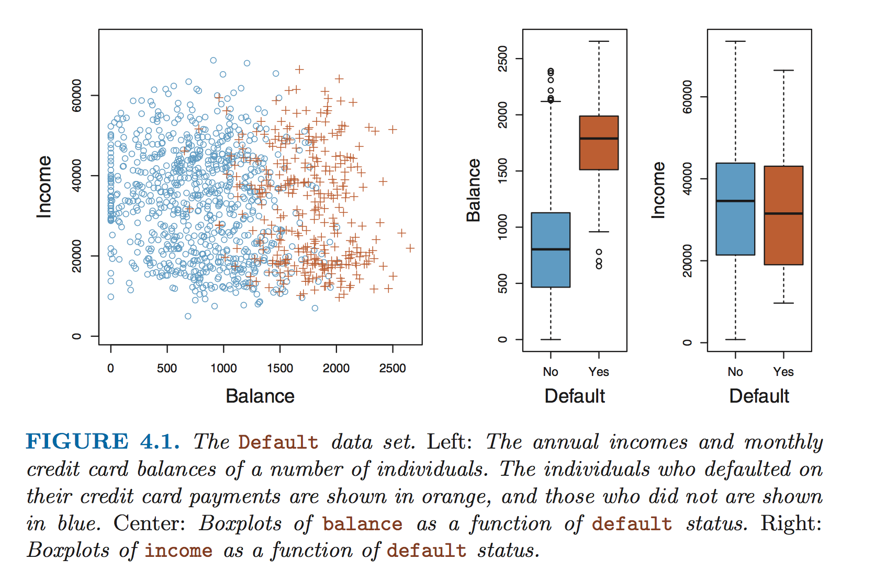
Strong Relationship Between Balance and Default. Not so much for Income.
Default=No
Default=Yes

Slide 10
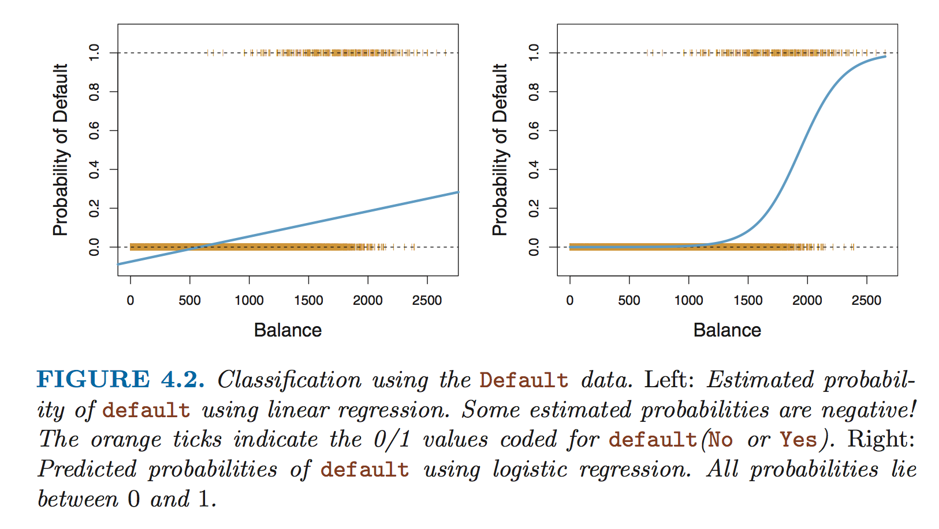
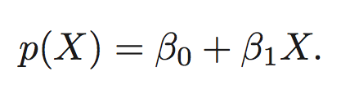
Fit a simple linear model using binary response encoding
Response encoding for lm fit:
Interpretation:
0 if No;
If Yes.
P(default = Yes | balance)
default =

Slide 11
Fit a simple linear model using binary response encoding
Response encoding for lm fit:
Interpretation:
0 if No;
If Yes.
P(default = Yes | balance)
default =
P(balance) > 0.1 => Yes
Probability values < 0 !!

Slide 12
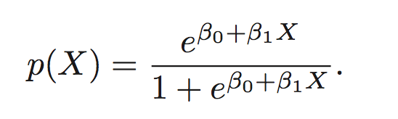
Logistic Model to the Rescue
Instead of our linear regression model:
Use a logistic regression model:

Slide 13
Logistic Regression Applied to the Default Data
Logistic regression:
Produces and S-shaped curve
All p(X) values between 0 and 1

Slide 14
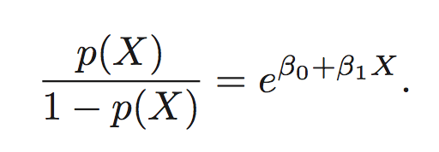
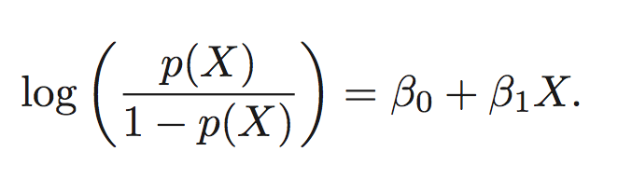
Logistic regression model:
Odds ratio:
Log-odds or logit is linear with respect to X
Increasing X by one unit changes the log-odds by B₁.
(or multiples the odds by e^{B1})
* The amount p(X) changes due to a one-unit change in X depends on X.

Slide 15
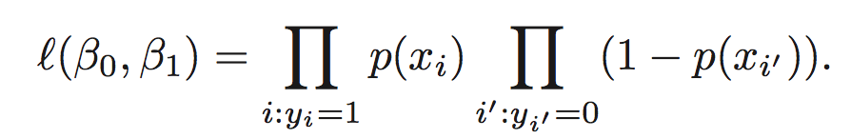
Estimating the Coefficients
Find B₀ and B₁ such that
those that defaulted have p(X) closest to 1
those that did not default have p(X) closest to 0
Computing the optimal B₀,B₁: find values for B₀,B₁ that maximizes the likelihood:
Probability that all those that did default, do default
Probability that all those that did NOT default, do NOT default

Slide 16
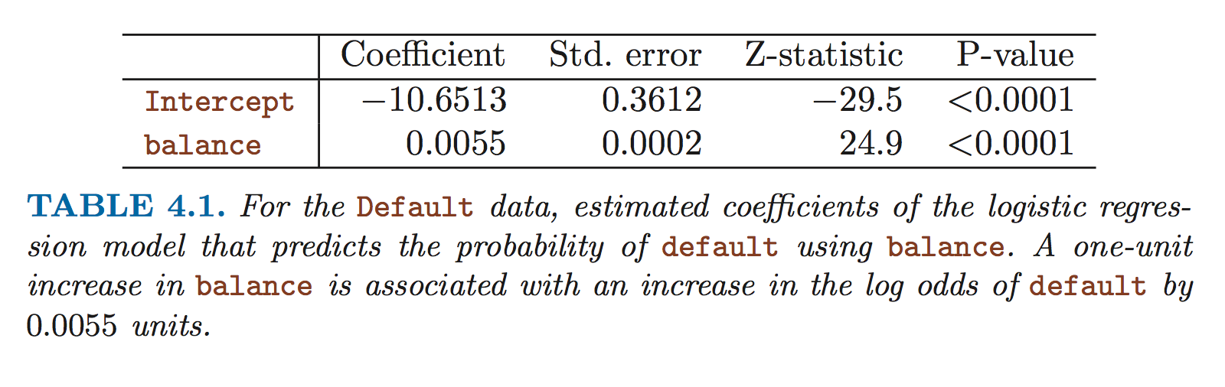


Results from Fitting Logistic Regression on the ‘default’ data
Null hypothesis
Implies
(in other words, p(default) does not depend on balance… reject the null due to small P!)
Note: intercept term is not of interest, serves to adjust probabilities for the number of ones and zeros in the data.

Slide 17
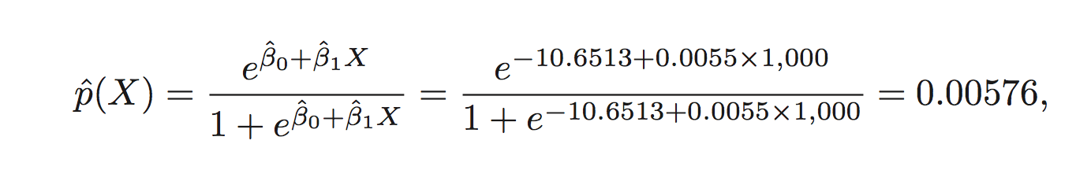
Make Predictions Using the Learned Coefficients
Just plug in the coefficients and the value for balance to get P(default)
Ie. For balance = $1000
P(default) is less than 1%, so we’ll say ‘No’

Slide 18
Logistic Regression Using Qualitative Variables
Earlier, computing P(default | balance) where balance is a numerical (quantitative) value.
Logistic regression can also be used to fit Qualitative (categorical) variables similarly as in linear regression – use Dummy variables.
Example: P(default | student) where student = {Yes, No}
Encode student status using dummy variable.
Fit
where X
Student = 1
Non-student = 0
P(default)
(all done using a single qualitative variable of student status, entirely ignoring balance)

Slide 19
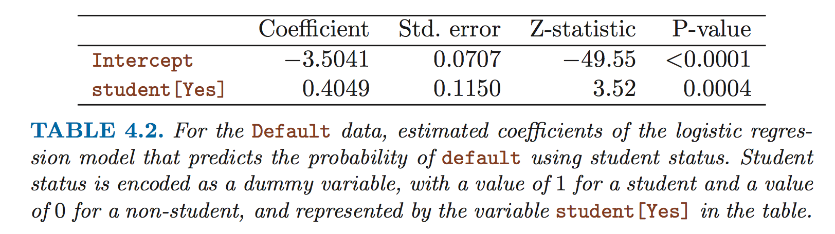
Logistic Regression Coefficient Fitted for Student Status
Coefficient is positive and statistically significant.
So, more likely to default if you’re a student.

Slide 20
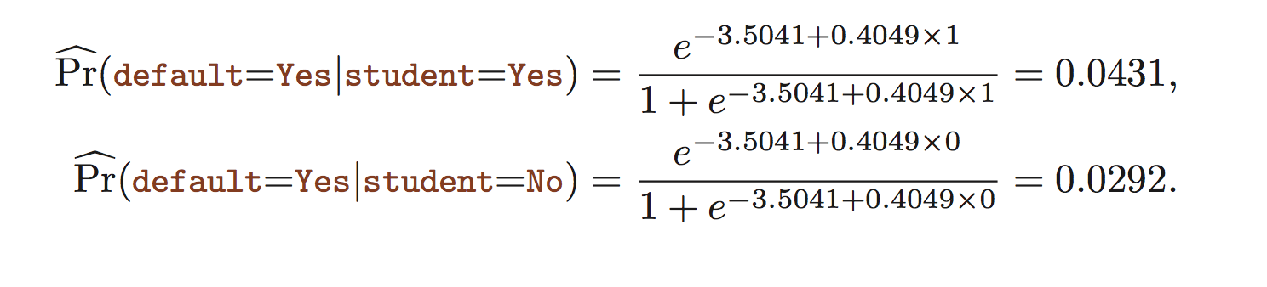
Can determine exact probabilities of default
for student vs. non-student
Just plug in the coefficients and dummy variable student status value
P(default) is higher for the student than the non-student.

Slide 21
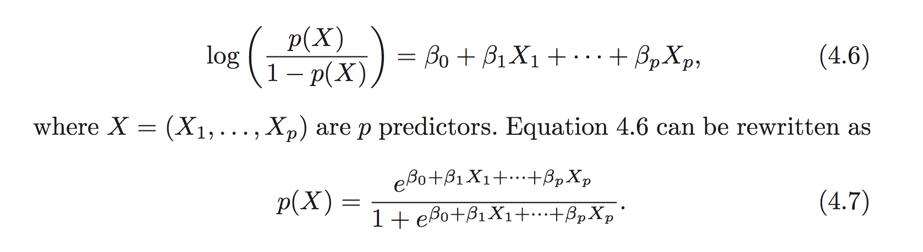
Multiple Logistic Regression
(can mix quantitative and qualitative explanatory variables, just as in linear regression)

Slide 22
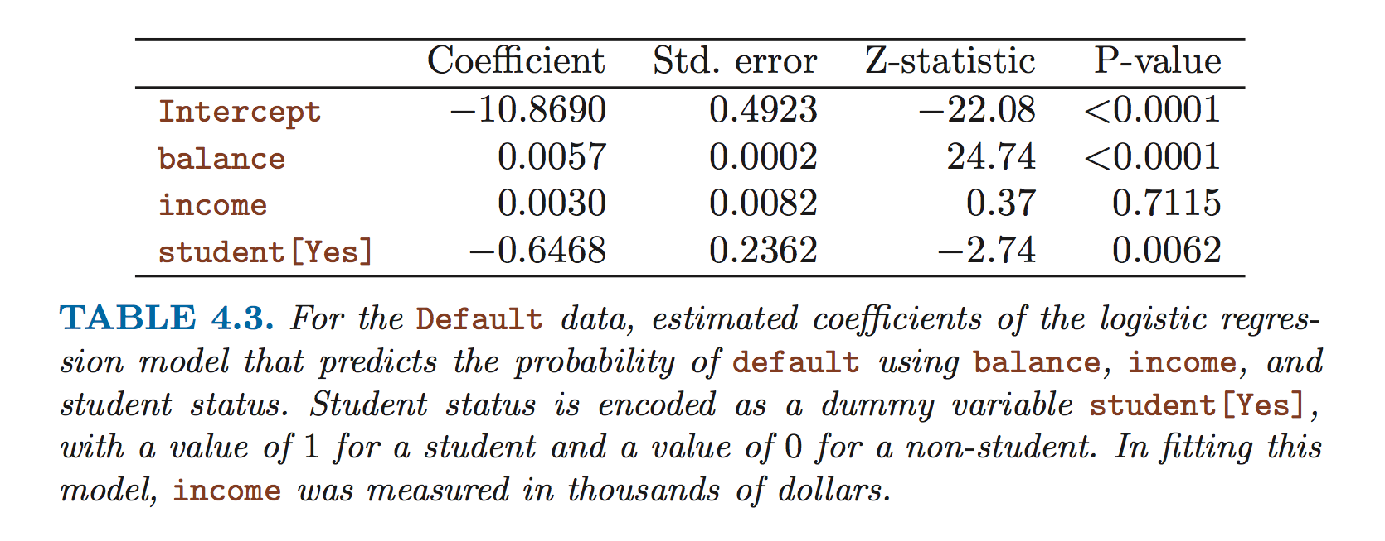
Fit coefficients for multiple logistic regression
Using
balance quantitative variable
Income quantitative variable
student qualitative variable
Balance and student status both statistically significant.
But… now a negative coefficient for student as compared to a positive coef earlier?

Slide 23
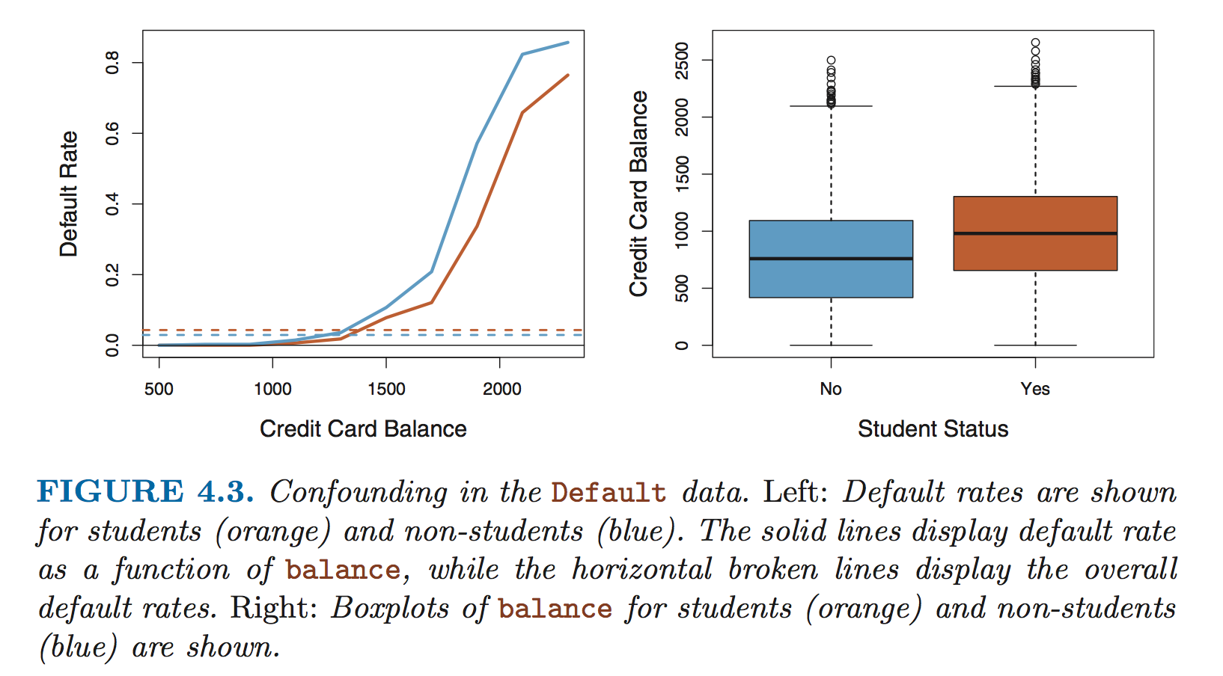
Non-student
At a given balance, student default rate is lower.
Student
Cumulatively (all balances and incomes), student default rate is slightly higher.

Slide 24
Can see that balances are higher for students than non-students, and this is a confounding correlative effect.
Beware: results from using one predictor alone may be different from models using multiple predictors! (especially when predictors are correlated)

Slide 25
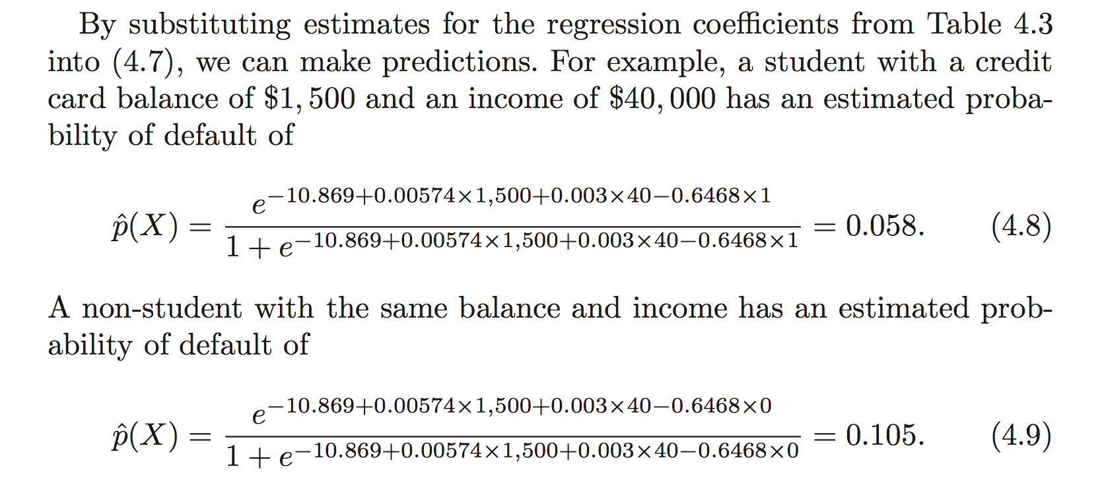
Again, compute probabilities for the response variable by plugging in coefficients and variable values.
Determine response classes based on these probability values.

Slide 26
Logistic Regression for > 2 response classes?
Don’t bother…. Just use LDA
Next week: Linear Discriminant Analysis (LDA)

